Slide 1
COMP28112 – Lecture 20
Grid and Cloud Computing
(and more…)
COMP28112 Lecture 20

Slide 2
An Early Experiment
The advent of the Internet made scientists think about the possibility of exploiting interconnected machines for time-consuming applications. E.g.:
Long Integer Factorisation (find the prime factors of an integer – remember: public-key cryptography relies upon the difficulty of finding the prime factors of long integers):
  Algorithms for integer factorisation might be time consuming: for integers whose factors are two primes of about the same size, no polynomial time algorithm (to find the factors) is known.
  http://en.wikipedia.org/wiki/Integer_factorization
COMP28112 Lecture 20

Slide 3
An Early Experiment (cont.)
Around 1990, the Internet mostly consists of Unix machines.
A C program (implementing an integer factorisation algorithm) was developed that would run on a machine when it was idle; it would use email to communicate with a server, to email results, to request data:
  At a time when factoring 100-digit-long integers would take one month using expensive machines, it was realized that with a good implementation such integers could be factored within a few days and for free!
  Read “factoring by electronic mail”, EUROCRYPT1989
COMP28112 Lecture 20

Slide 4
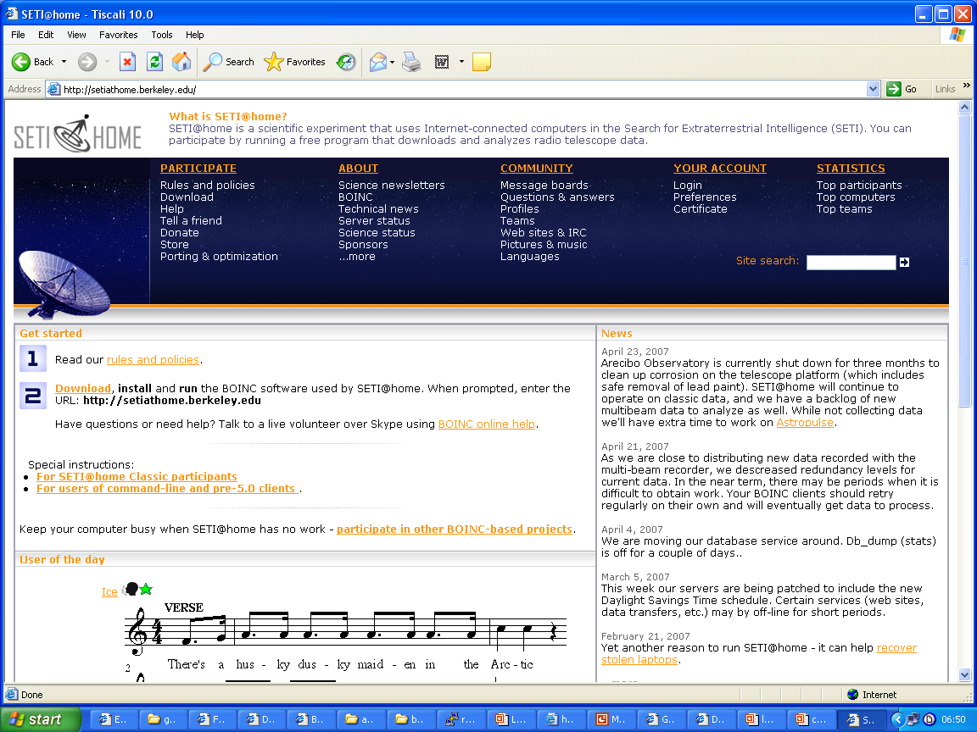
SETI @ HOME
(download and analyse radio telescope data)
COMP28112 Lecture 20

Slide 5
Is all this (number crunching) useful?
Science (and human progress) rely on curiosity…
Frank Nelson Cole found in 1903 the prime factors of 2⁶⁷–1:
  2⁶⁷–1 = 193707721 × 761838257287
  How long did it take him? “Three years on Sundays”. How long would it take today?
(read: “In Praise of Science: Curiosity, Understanding, and Progress”)
COMP28112 Lecture 20

Slide 6
The origins of the Grid
The term ‘Grid’ was coined around 1996.
  It was used to describe a hardware and software infrastructure that was needed by the rapidly growing and highly advanced community of High Performance Computing (HPC):
    HPC refers to the use of (parallel) supercomputers and computer clusters linked together in a way that provides high-end capabilities; the latter are needed for a number of scientific applications (‘big science’).
WARNING: This was a vision!
COMP28112 Lecture 20

Slide 7
What is the vision of the Grid?
“A computational Grid is a hardware and software infrastructure that provides dependable, consistent, pervasive and inexpensive access to high-end computational capabilities”
  (“The Grid: Blueprint for a New Computing Infrastructure”,1998)
Why ‘Grid’?
  Electricity Grid: “A network of high-voltage transmission lines and connections that supply electricity from a number of generating stations to various distribution centres, so that no consumer is dependent on a single station”.
  As early as 1969, it was suggested that: “We will probably see the spread of computer utilities, which, like present electric and telephone utilities, will service individual homes and offices across the country”.
COMP28112 Lecture 20

Slide 8
So, what is the Grid?
The original term was ‘catchy’
  Soon, researchers started talking about:
    Data Grids
    Knowledge Grids
    Access Grids
    Science Grids
    Bio Grids
    Sensor Grids
    Campus Grids
    Tera Grids
    Commodity Grids, and so on…
  The sceptic would wonder if there was more to the Grid than a ‘funding concept’.
COMP28112 Lecture 20

Slide 9
A Grid checklist
The Grid coordinates resources that are not subject to centralized control … (i.e., resources of different companies, or different administrative domains)
… using standard, open, general-purpose protocols and interfaces…
… to deliver non-trivial qualities of service (for example, related to response time, throughput, availability, security, …)
COMP28112 Lecture 20

Slide 10
Defining the Grid…
There are competing definitions, defining it as:
  An implementation of distributed computing
  A common set of interfaces, tools, APIs, …
  The ability to coordinate resources across different administrative domains (creating Virtual Organisations)
  A means to provide an abstraction (virtualisation) of resources, services, …
  Resource sharing and coordinated problem solving in dynamic virtual organisations
COMP28112 Lecture 20

Slide 11
Grid computing must provide…
Resource discovery and information collection and publishing
Data Management on and between resources
Process Management on and between resources
Common Security Mechanisms
Process and Session Recording/Accounting
COMP28112 Lecture 20

Slide 12
Some middleware available…
Globus (http://www.globus.org)
  GridFTP (extensions to FTP protocol to cope with HPC and Grid Security)
  OGSA-DAI (http://www.ogsadai.org.uk/): standard approach for data access on the Grid
  WS-Resource Framework: allows the use of established Web Services standards (slow, complex, …).
Condor, Condor-G, HTCondor (http://research.cs.wisc.edu/htcondor/)
  Workload Management for compute-intensive jobs
COMP28112 Lecture 20

Slide 13
Some Grid Infrastructures
(and beyond the Grid…)
Teragrid, now Extreme Science and Engineering Digital Environment (http://www.teragrid.org/)
  http://access.ncsa.uiuc.edu/witg/
Datagrid (http://eu-datagrid.web.cern.ch/eu-datagrid/)
  http://real1.rm.cnr.it:8081/ramgen/Grid/Grid.rm
UK National Grid Service (http://www.ngs.ac.uk/)
Many more national initiatives…
Learn about the grid: http://www.gridcafe.org/
Beyond the Grid:
  GLORIAD: http://www.gloriad.org/
  PlanetLab: http://www.planet-lab.org/
COMP28112 Lecture 20

Slide 14
Grid Computing Summary
There is a lot of hype around grid computing…
…but there is real-world value in e-science, e-business…
…through virtualisation of the underlying distributed resources!
The Large Hadron Collider Grid has been set up to support the Large Hadron Collider experiment:
  http://wlcg.web.cern.ch/
There has been related research in the School
COMP28112 Lecture 20

Slide 15
Cloud Computing
Largely evolved from the Grid.
The idea:
  On-demand resource provisioning. Users of the Cloud are consumers who don’t have to own the resources they use; these resources are provided by others (providers) as a service!
Associated concepts:
  Software as a service (SaaS)
  Platform as a service (PaaS)
  Infrastructure as a service (IaaS)
COMP28112 Lecture 20

Slide 16
Virtualisation: the key concept
In the same way that resources of a single computer are virtualised by traditional OSs, a cloud computing layer can virtualise multiple computers.
App
App
App
App
App
App
OS
OS
OS
Operating System
Virtualisation
Hardware
Hardware
Hardware
Traditional View
Virtualized View
COMP28112 Lecture 20

Slide 17
Grid & Cloud
Similarities: Scalability, Divide and Conquer, Lots of Data, SLAs, …
Differences: The Grid has a tighter relation between users and administrators; the execution model on the Grid is more restrictive.
A subject for debate:
  http://www.ibm.com/developerworks/web/library/wa-cloudgrid/
  http://ianfoster.typepad.com/blog/2008/08/cloud-grid-what.html
The Cloud has raised privacy concerns.
For an example of a Cloud Computing service: Amazon’s EC2: http://aws.amazon.com/ec2/
Grids and (even more) Clouds are here to stay!
COMP28112 Lecture 20

Slide 18
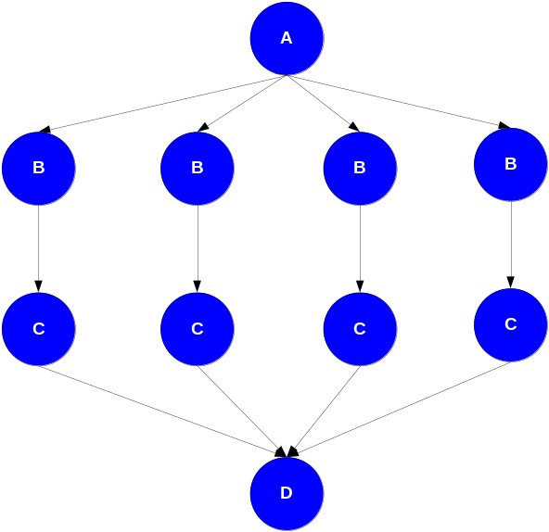
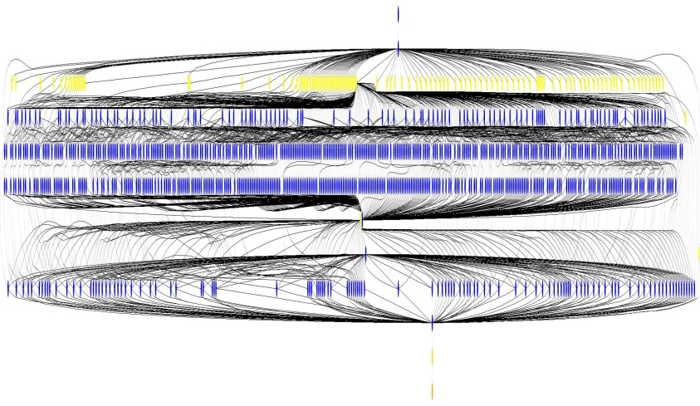
The Applications…
Often, these are scientific workflows consisting of sequences of tasks. Tasks may be partitioned into parallel tasks each of which operates on different data (a technique known as divide-and-conquer)
Tools are available to enable the automatic composition of the workflows and their mapping onto resources
  http://pegasus.isi.edu/
Applications in astronomy, earth sciences, bioinformatics, …
COMP28112 Lecture 20

Slide 19
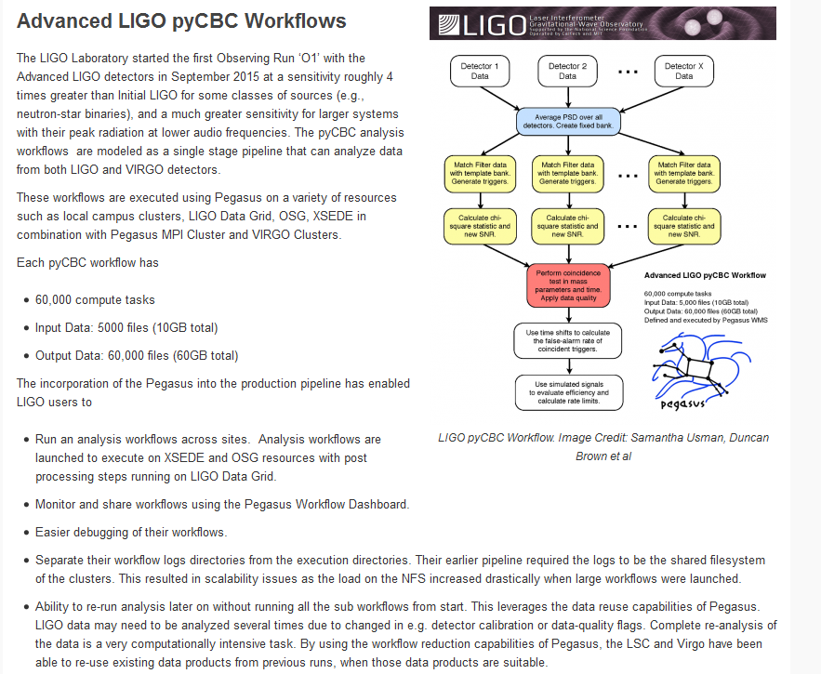
https://pegasus.isi.edu/application-showcase/ligo/

Slide 20
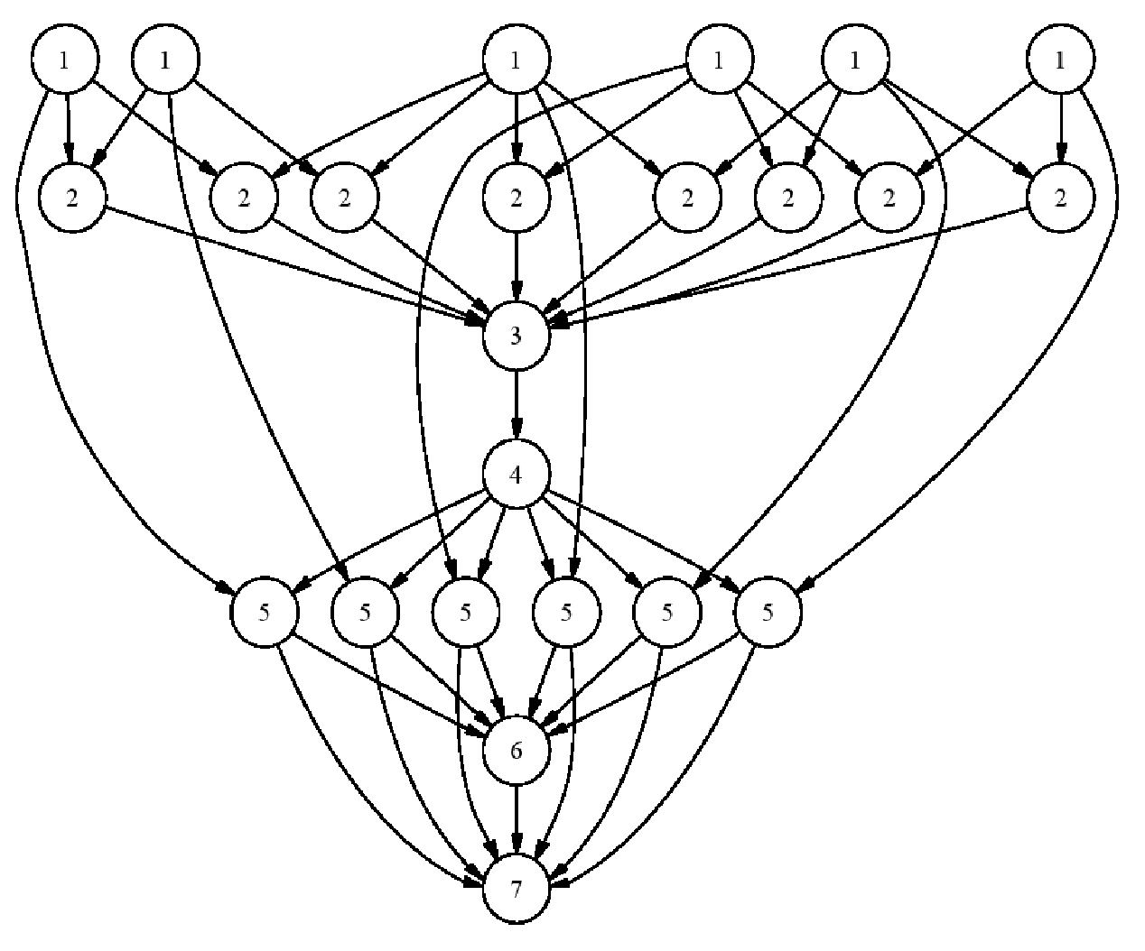
Remember in Lecture 2?
COMP28112 Lecture 20

Slide 21
Dealing with large data sets
Speed-up processing by parallelizing the operations!
Map-Reduce Framework
  Apache Hadoop: open source implementation
The ‘Big Data’ fashion/obsession/buzzword…
  Data + Framework + Algorithms = Knowledge?
  http://lsst.org/lsst/google: 30TB of data every night
  LHC@CERN: 1 petabyte of data per second
COMP28112 Lecture 20

Slide 22
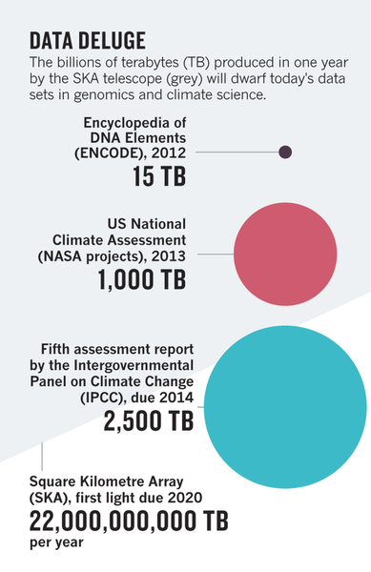
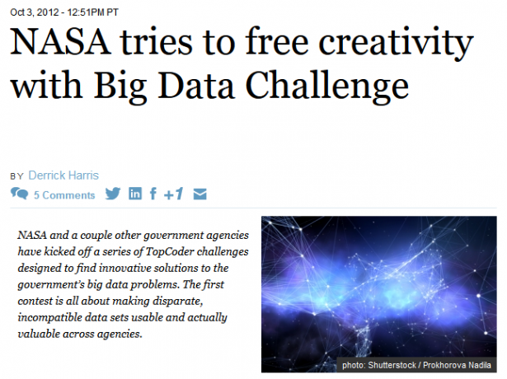
A challenge for the future…
The huge amounts of data we can collect and process will offer us great opportunities to improve quality of life and shape progress in a way that benefits everybody but to achieve this we need a better understanding of the challenges in handling and analyzing large-scale data including new technologies…
COMP28112 Lecture 20

Slide 23
Finally…
Motivating some advanced problems
(but first some statistics about lab 2)
COMP28112 Lecture 20

Slide 24
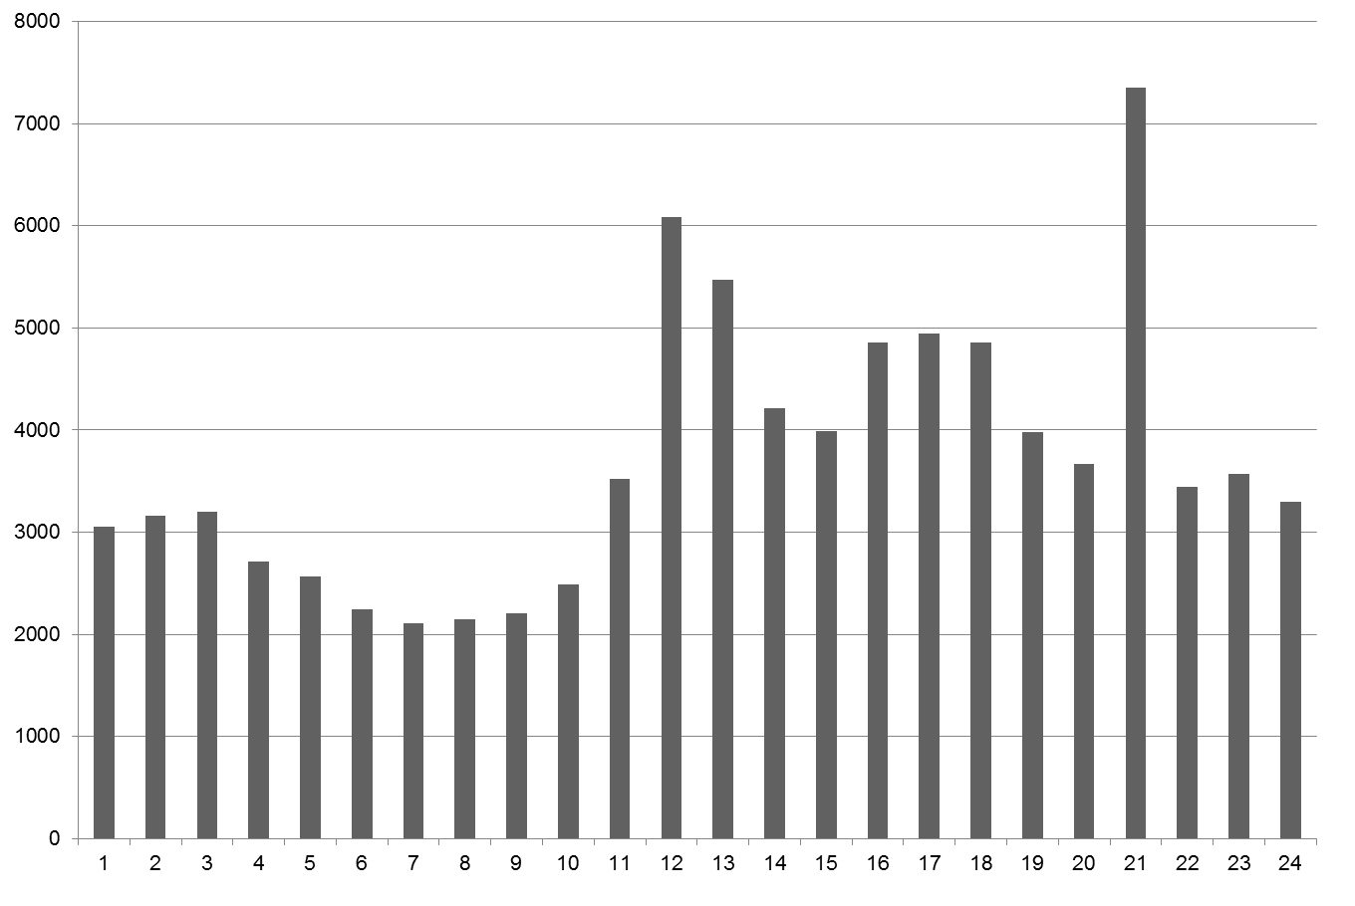
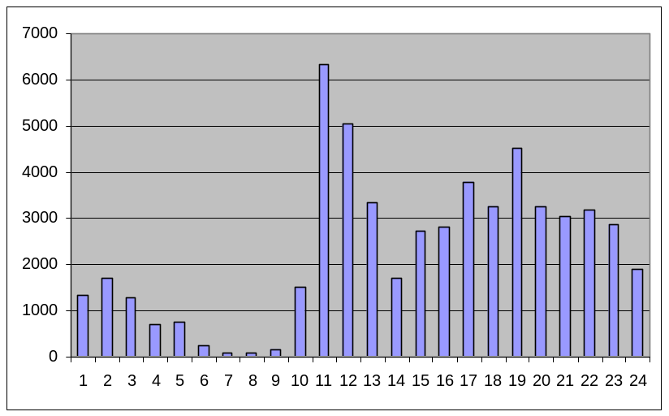
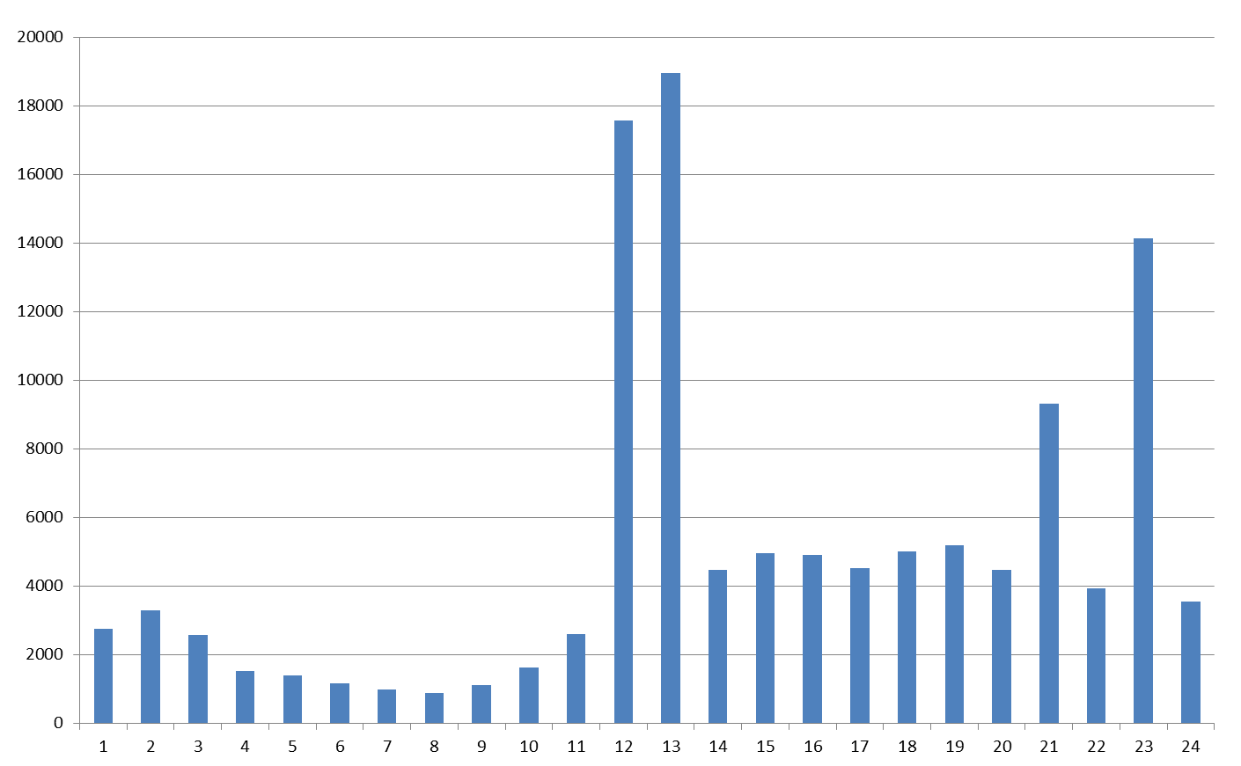
Messages to the server based on hour of the day (0-1, 1-2, …, 23-24)
2013
2014
2015
(120853 messages)
2016
?

Slide 25
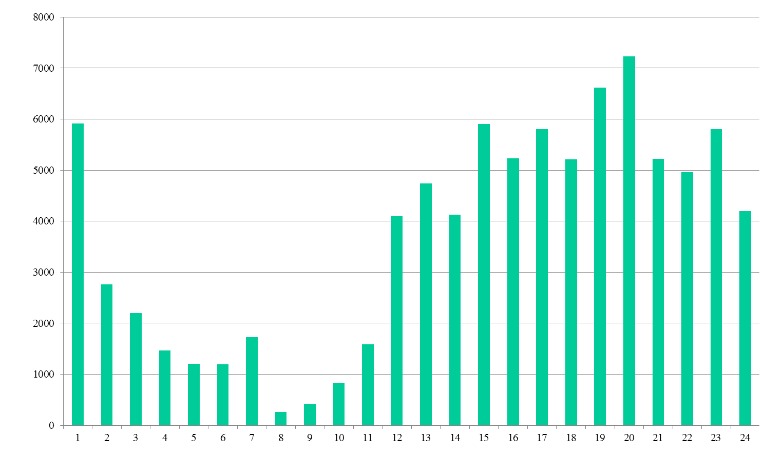
(88718) Messages to the server based on hour of the day (0-1, 1-2, …, 23-24)

Slide 26
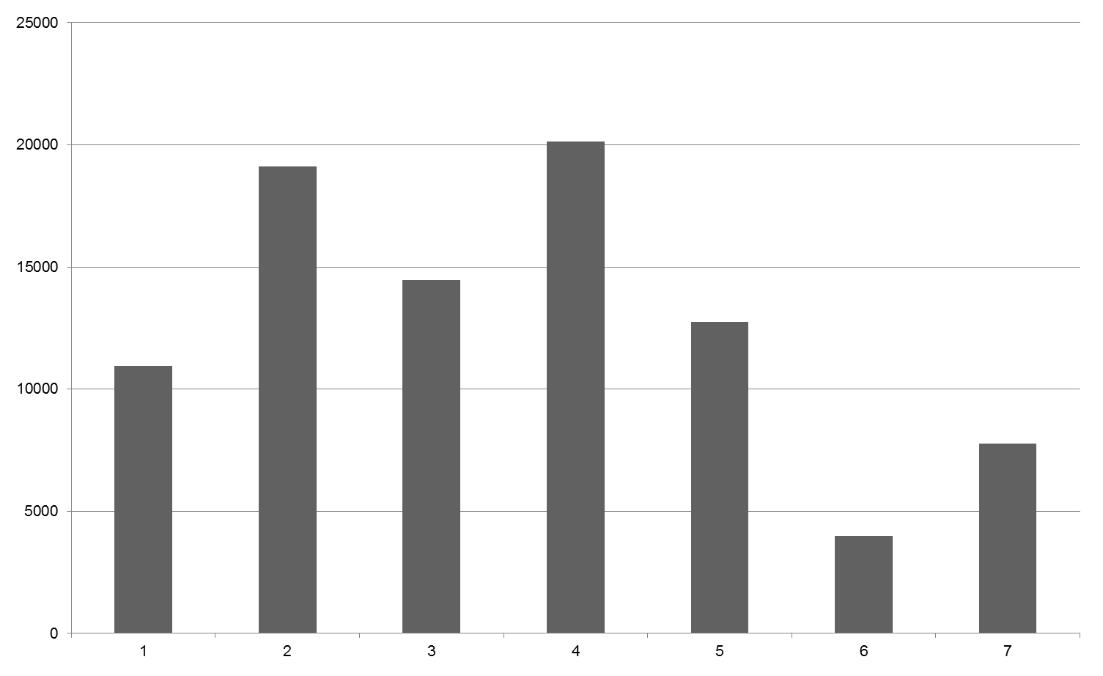
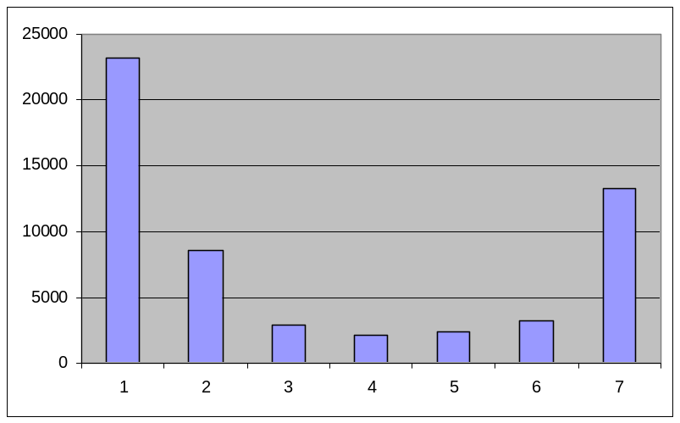
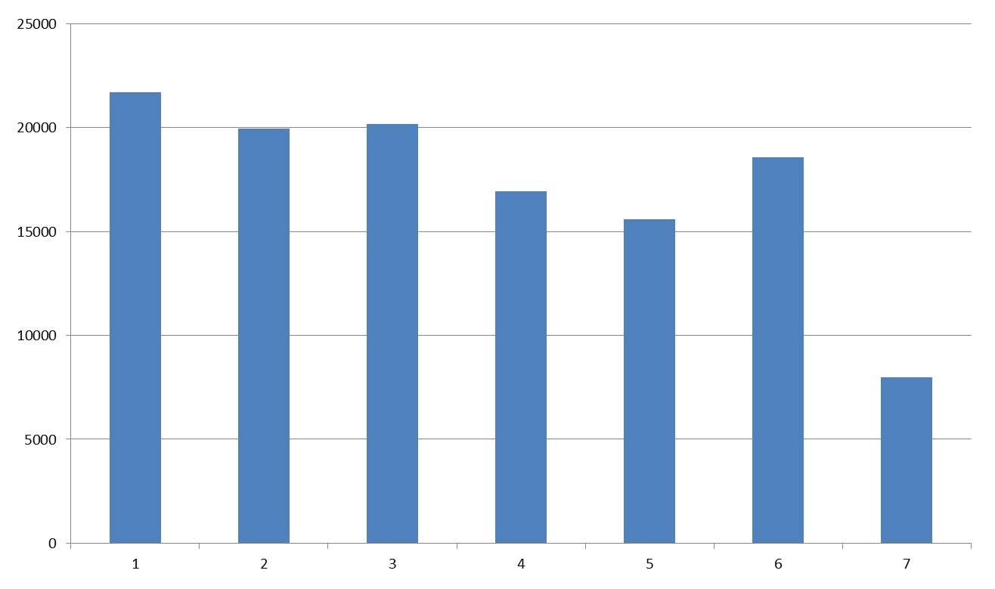
What day of the week was busiest? (1: Mon, 7: Sun)
2014
2013
2015
2016
?

Slide 27
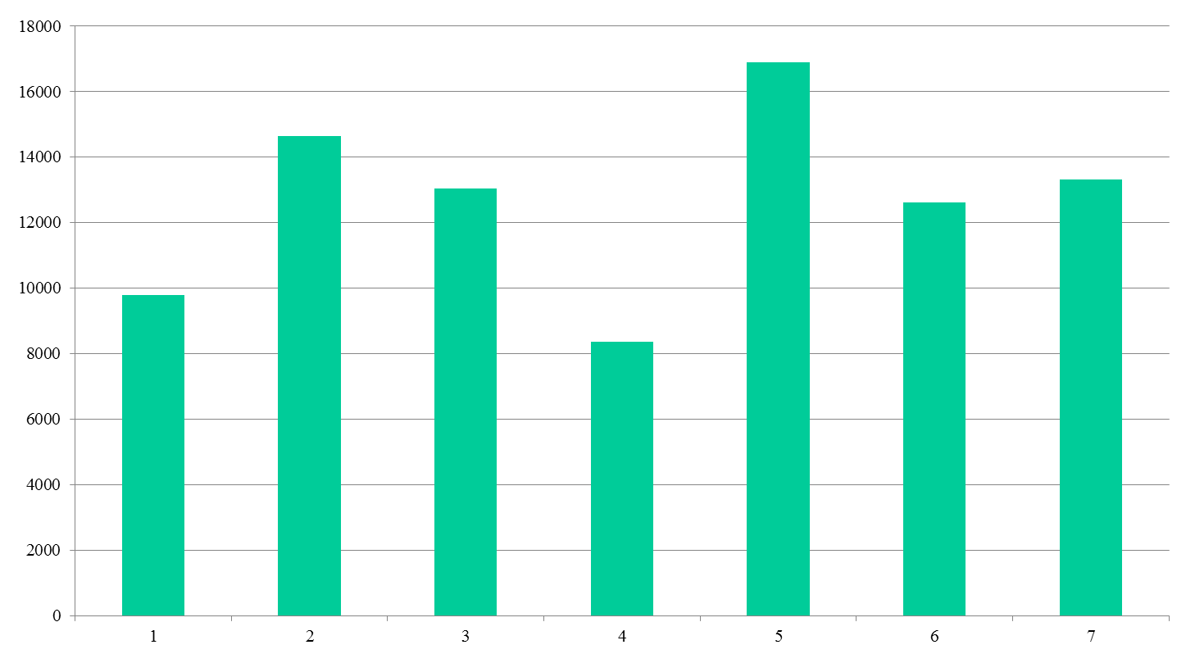
What day of the week was busiest? (1: Mon, 7: Sun)

Slide 28
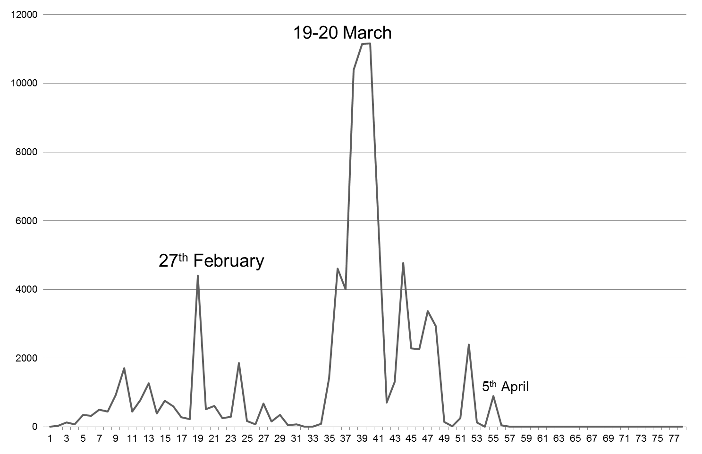
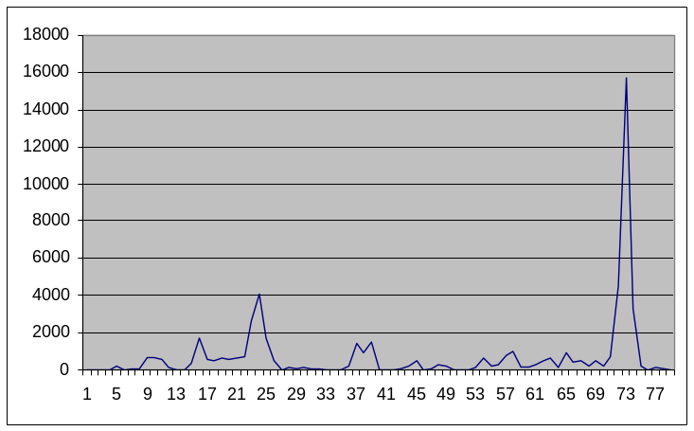
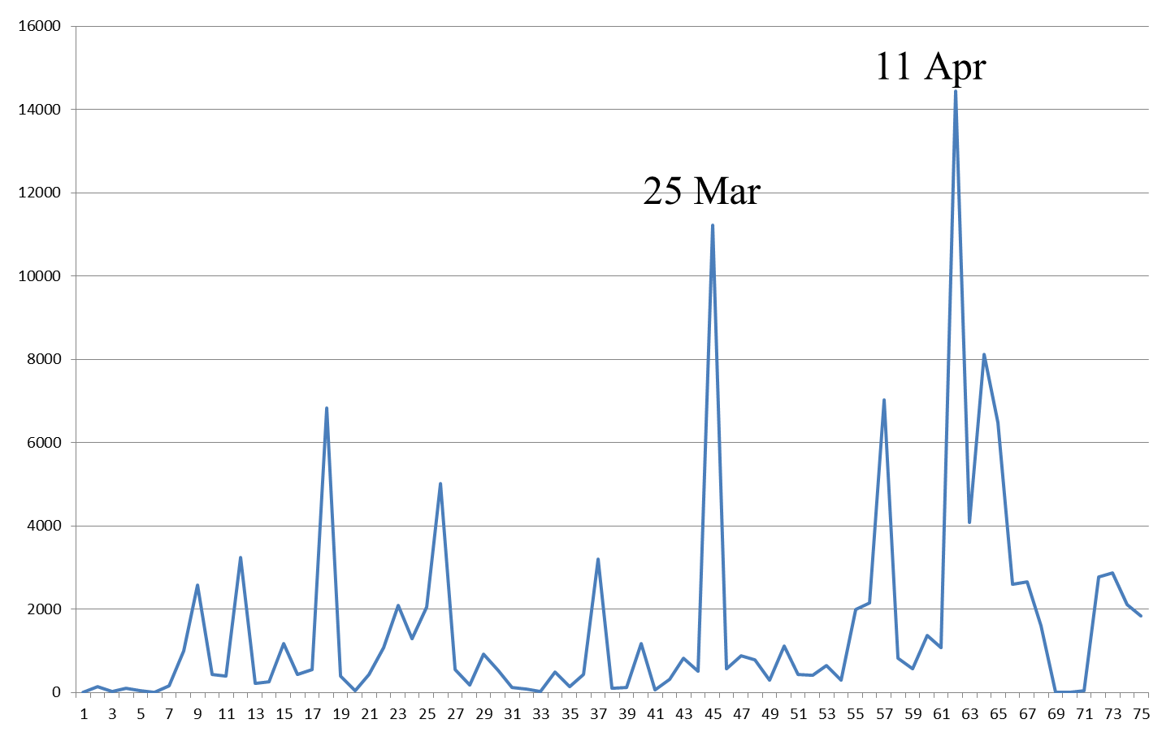
Messages since 9/2/2014 (=day 1)
23rd April
2013
2014
4th March
2015

Slide 29
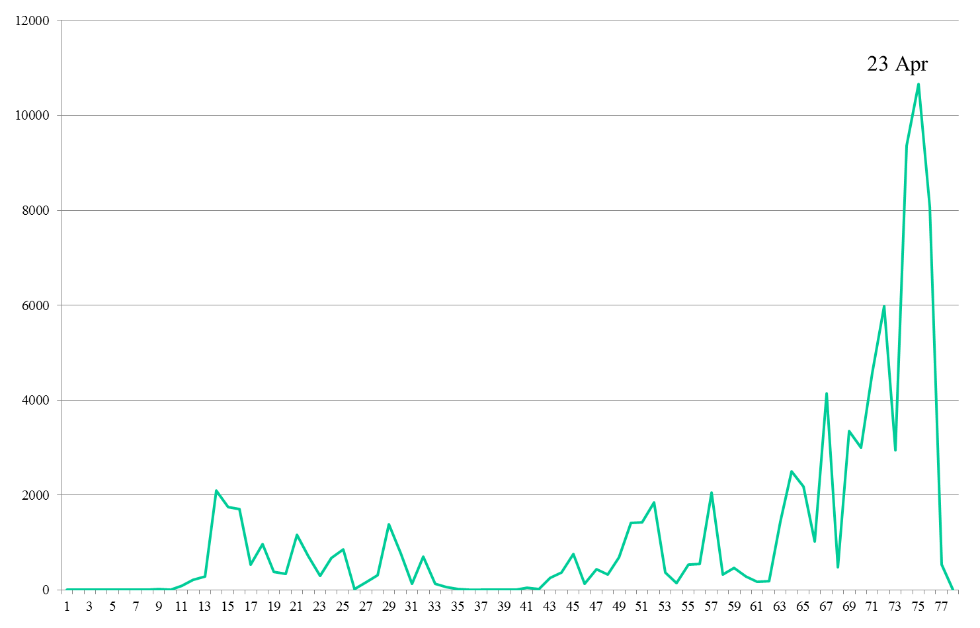
Messages since 9/2/2016 (=day 1)
22 Feb

Slide 30
Some problems…
When is it best to execute two tasks on one machine as opposed to one task on one machine + communication (data transfer) and computation on another?
How to design random values, which are not uniform? E.g., two-digit integer where the probability is: 0-9 (90%) and 10-99 (10%)
How to compute the average of streamed data? (related to lab exercise 3, where you have to compute the average over large values)
Split the following loop, so that each of 4 threads takes the same amount of computation. Rewrite, in terms of t, where t is between 0 and 3.
for(i=0;i<1000;i++)
{ some_computation_on_i; }
Marking sessions for the labs: May 10, 11, 13
All your lab work should be marked by May 13!

